Slide 1


2024 HCA Single-Cell Omics in-person Computational and Experimental Design Workshop Single-cell multiomics (scRNA + scATAC)
June 24-28, 2024
Bangkok, Thailand

Slide 2
Computational track schedule
 | Beginner | Advanced
Monday | Preprocessing/QC | Data integration/cell type annotation/DE
Tuesday | Clustering/DE/data integration/cell type annotation | multi-omics/DA
Wednesday | TCR/BCR/CITE-Seq
Thursday | Trajectory inference/cell-cell communication
Friday | project/presentation

Slide 3
Goals for the day
Introduce key principles of single-cell epigenetics
Discuss example papers of single-cell multi-omic analyses
Convey considerations and challenges with analyzing single-cell multi-omics
Hands-on data analysis workshop!

Slide 4
We encourage you to ask questions!
https://shorturl.at/Kysq1

Slide 5
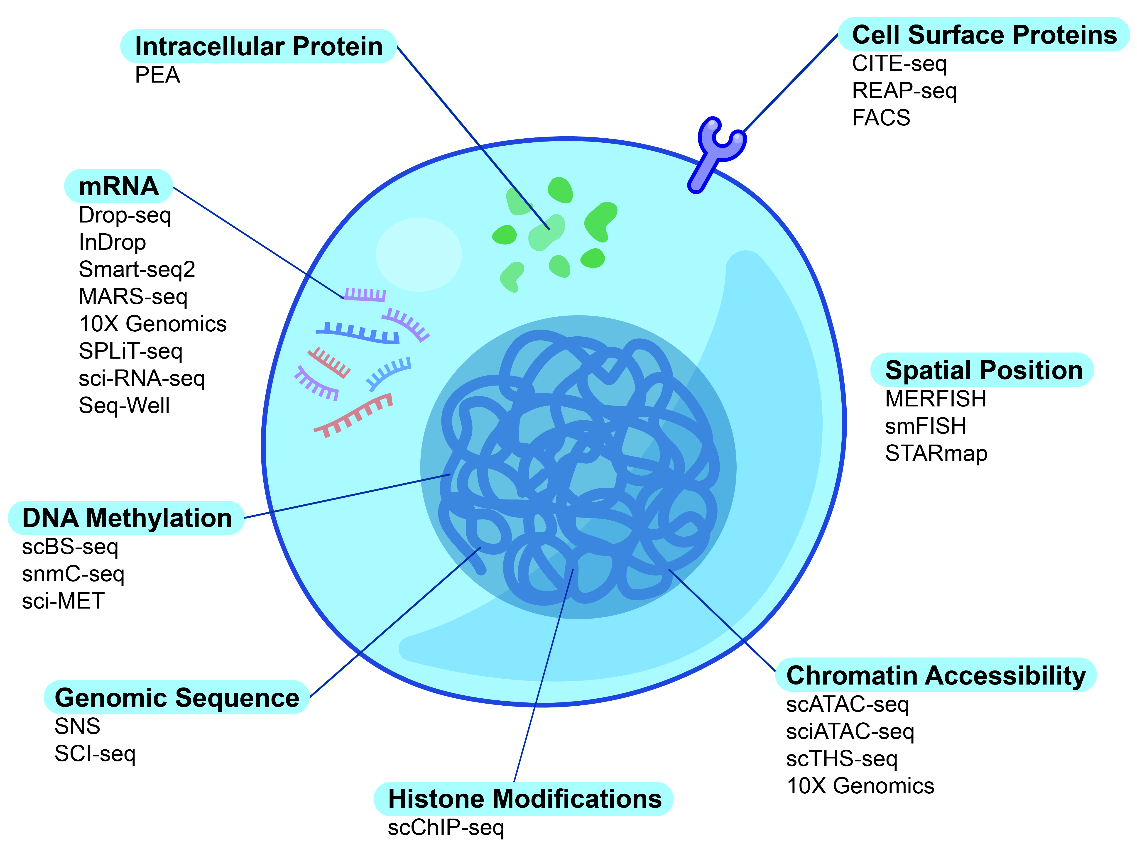
Profiling Cellular and Molecular Diversity
Adapted from: Stuart et al, Nature Reviews Genetics (2019)

Slide 6
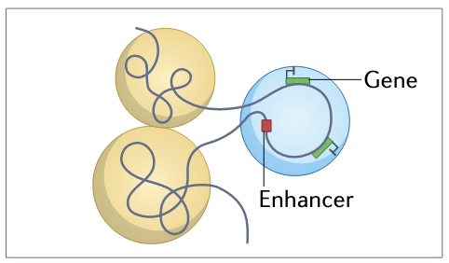
Looping and distal enhancers: What are these?
Enhancer: Stretch of DNA that becomes bound by transcription factors to regulate transcription of distal genes
Can be close to target gene, or hundreds of thousands of base pairs away
Can act on one gene or multiple genes
Can even have other genes in between enhancer and target gene
https://shorturl.at/Kysq1
Cuartero*, Stik*, Stadhouers*, Nature Reviews Immunology (2023)

Slide 7
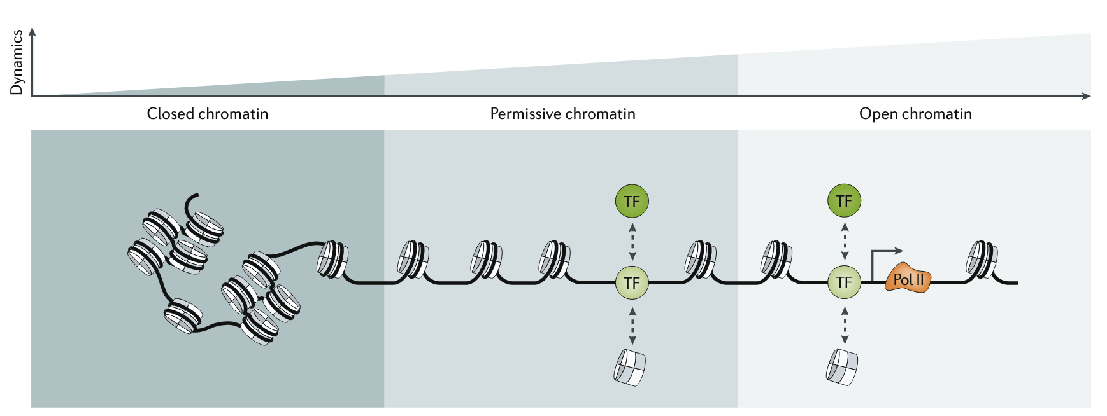
Epigenetics: What is this exactly?
Epigenetics: Heritable changes without altering genomic sequences
Most often measured: chromatin accessibility via (sc)ATAC-seq
https://shorturl.at/Kysq1
Figure from Klemm, Shipony, Greenleaf, Nature Reviews Genetics (2019)

Slide 8
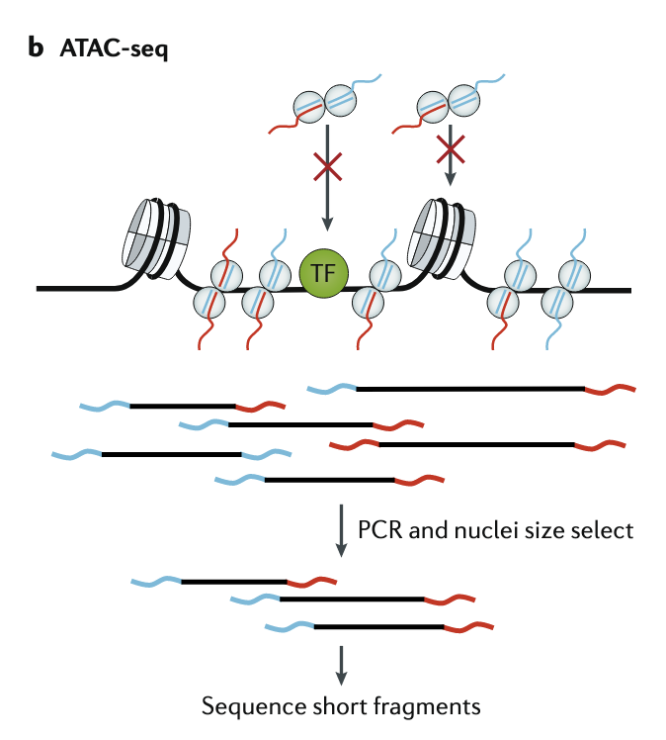
Epigenetics: What is this exactly?
Epigenetics: Heritable changes without altering genomic sequences
Most often measured: chromatin accessibility via (sc)ATAC-seq
How does ATAC-seq work?
Open chromatin gets digested by tagmentase -> insert known sequences
Sequence where tagmentase digested and inserted known sequences
https://shorturl.at/Kysq1
Figure from Klemm, Shipony, Greenleaf, Nature Reviews Genetics (2019)

Slide 9
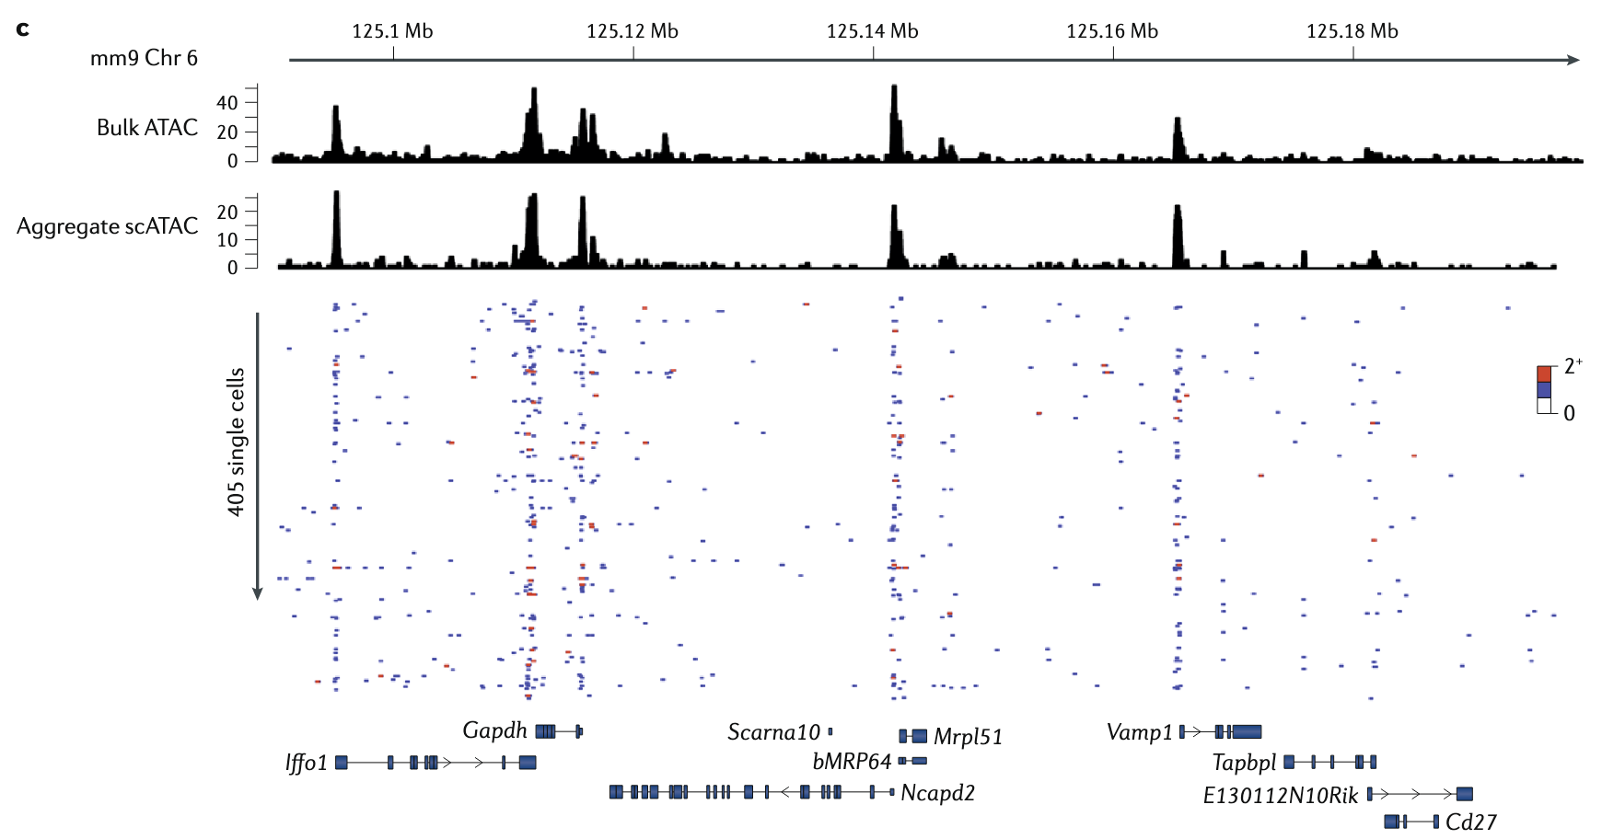
What does (sc)ATAC-seq data look like?
Measured feature: how accessible genomic sites are to tagmentation
Key: These genomic sites can be anywhere in genome
Enhancer, promoter, intron, exon, intergenic…
scATAC-seq output: cells * genomic regions matrix
Each entry in matrix = how accessible that region was to tagmentation
https://shorturl.at/Kysq1
Figure from Klemm, Shipony, Greenleaf, Nature Reviews Genetics (2019)

Slide 10
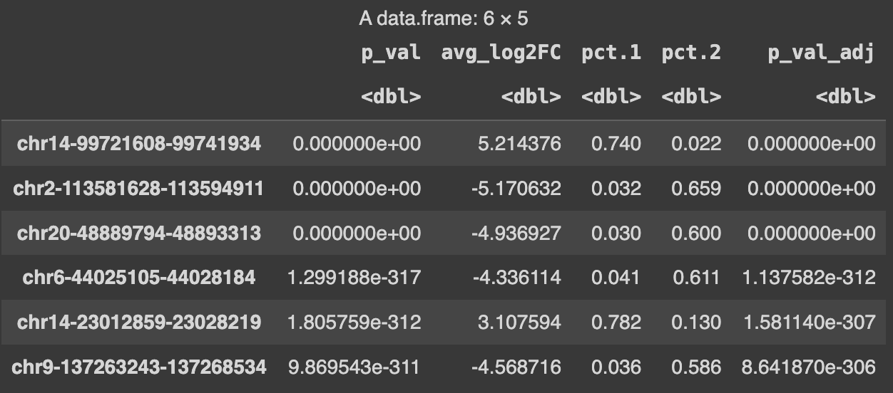
What can we do with scATAC-seq data?
Key question: how to interpret arbitrary genomic regions?
https://shorturl.at/Kysq1

Slide 11
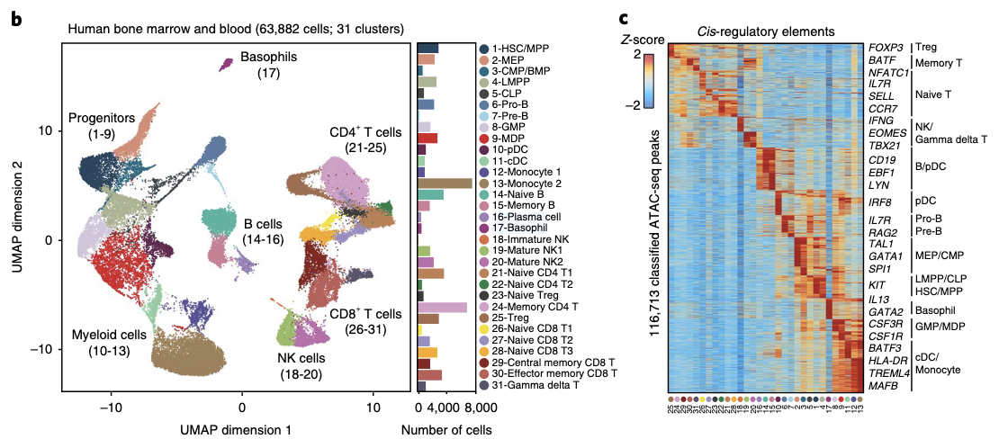
What can we do with scATAC-seq data?
Key question: how to interpret arbitrary genomic regions?
Assign peaks to closest genes
https://shorturl.at/Kysq1
Figure from Satpathy*, Granja*, et al. Nature Biotechnology (2019)

Slide 12
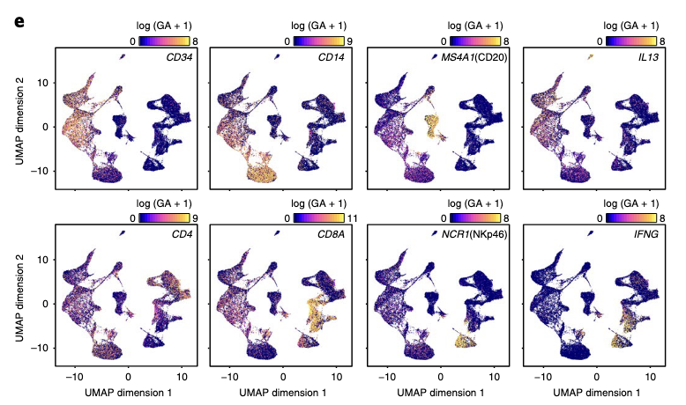
What can we do with scATAC-seq data?
Key question: how to interpret arbitrary genomic regions?
Assign peaks to closest genes
Sum chromatin accessibility in regions “linked” to a gene
https://shorturl.at/Kysq1
Figure from Satpathy*, Granja*, et al. Nature Biotechnology (2019)

Slide 13
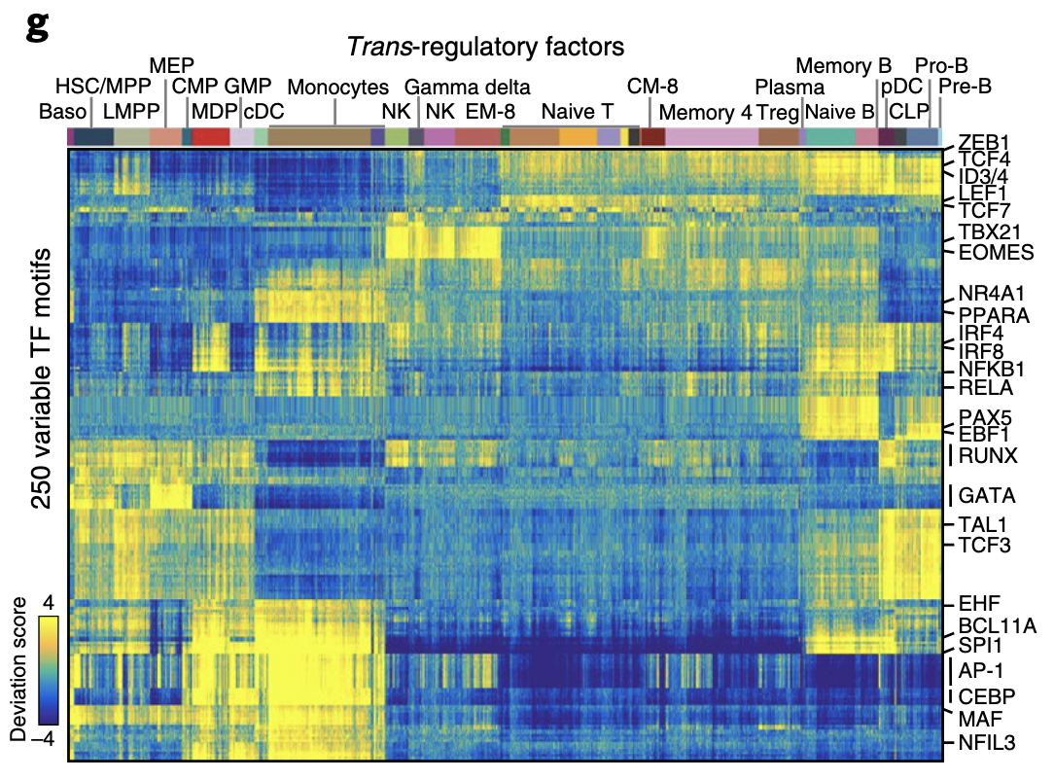
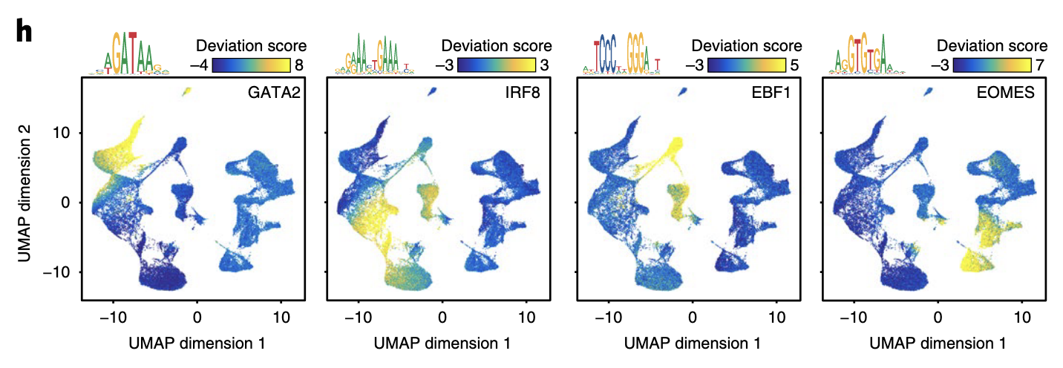
What can we do with scATAC-seq data?
Key question: how to interpret arbitrary genomic regions?
Assign peaks to closest genes
Sum chromatin accessibility in regions “linked” to a gene
Look for transcription factors that bind to motifs within each region
Figure from Satpathy*, Granja*, et al. Nature Biotechnology (2019)

Slide 14
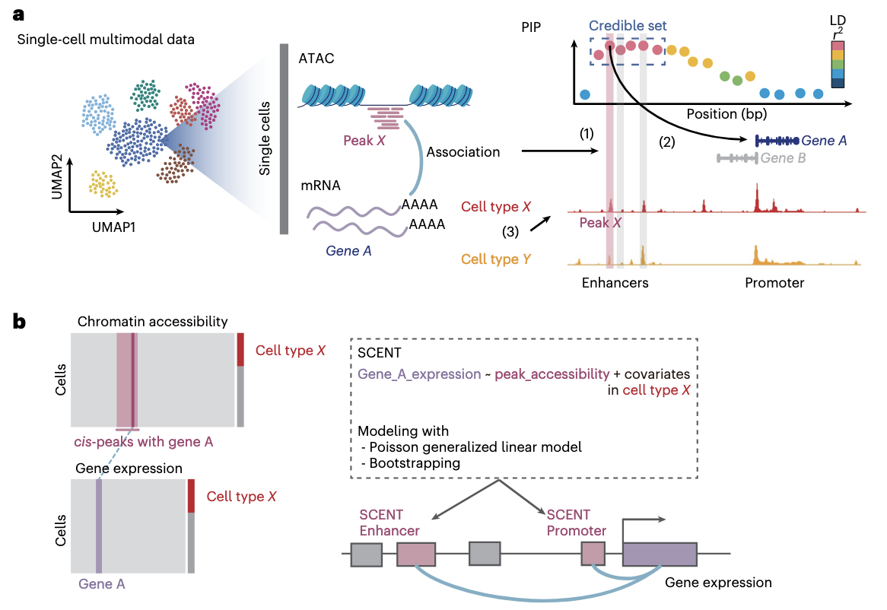
What is uniquely unlocked by having scRNA and scATAC-seq?
Modeling of gene regulatory relationships!
Gene expression as a function of…
Chromatin accessibility at distal chromatin peaks
Other covariates (e.g., batches, quality metrics, etc.)
Transcription factor expression or binding within chromatin peaks
https://shorturl.at/Kysq1
Figure from Sakaue et al., Nature Genetics (2024)

Slide 15
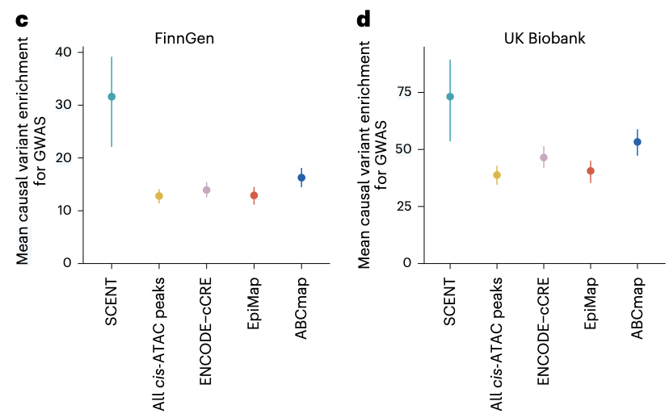
What is uniquely unlocked by having scRNA and scATAC-seq?
Modeling of gene regulatory relationships!
What are examples of single-cell multi-omic analyses?
Hypothesis prioritization for causal variants in GWAS or eQTL studies
https://shorturl.at/Kysq1
Figure from Sakaue et al., Nature Genetics (2024)

Slide 16
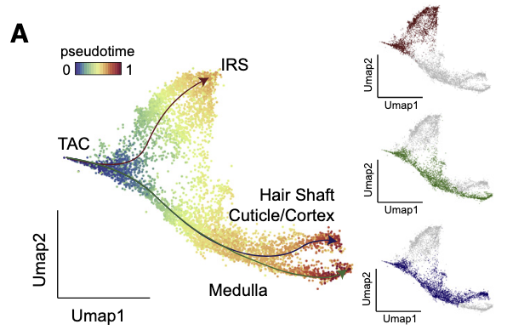
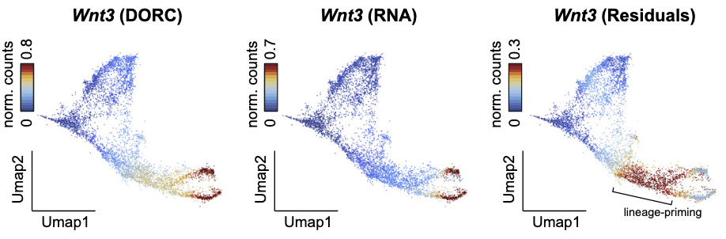
What is uniquely unlocked by having scRNA and scATAC-seq?
Modeling of gene regulatory relationships!
What are examples of single-cell multi-omic analyses?
Hypothesis prioritization for causal variants in GWAS or eQTL studies
Epigenetic priming
https://shorturl.at/Kysq1
Figure from Ma et al., Cell (2020)

Slide 17
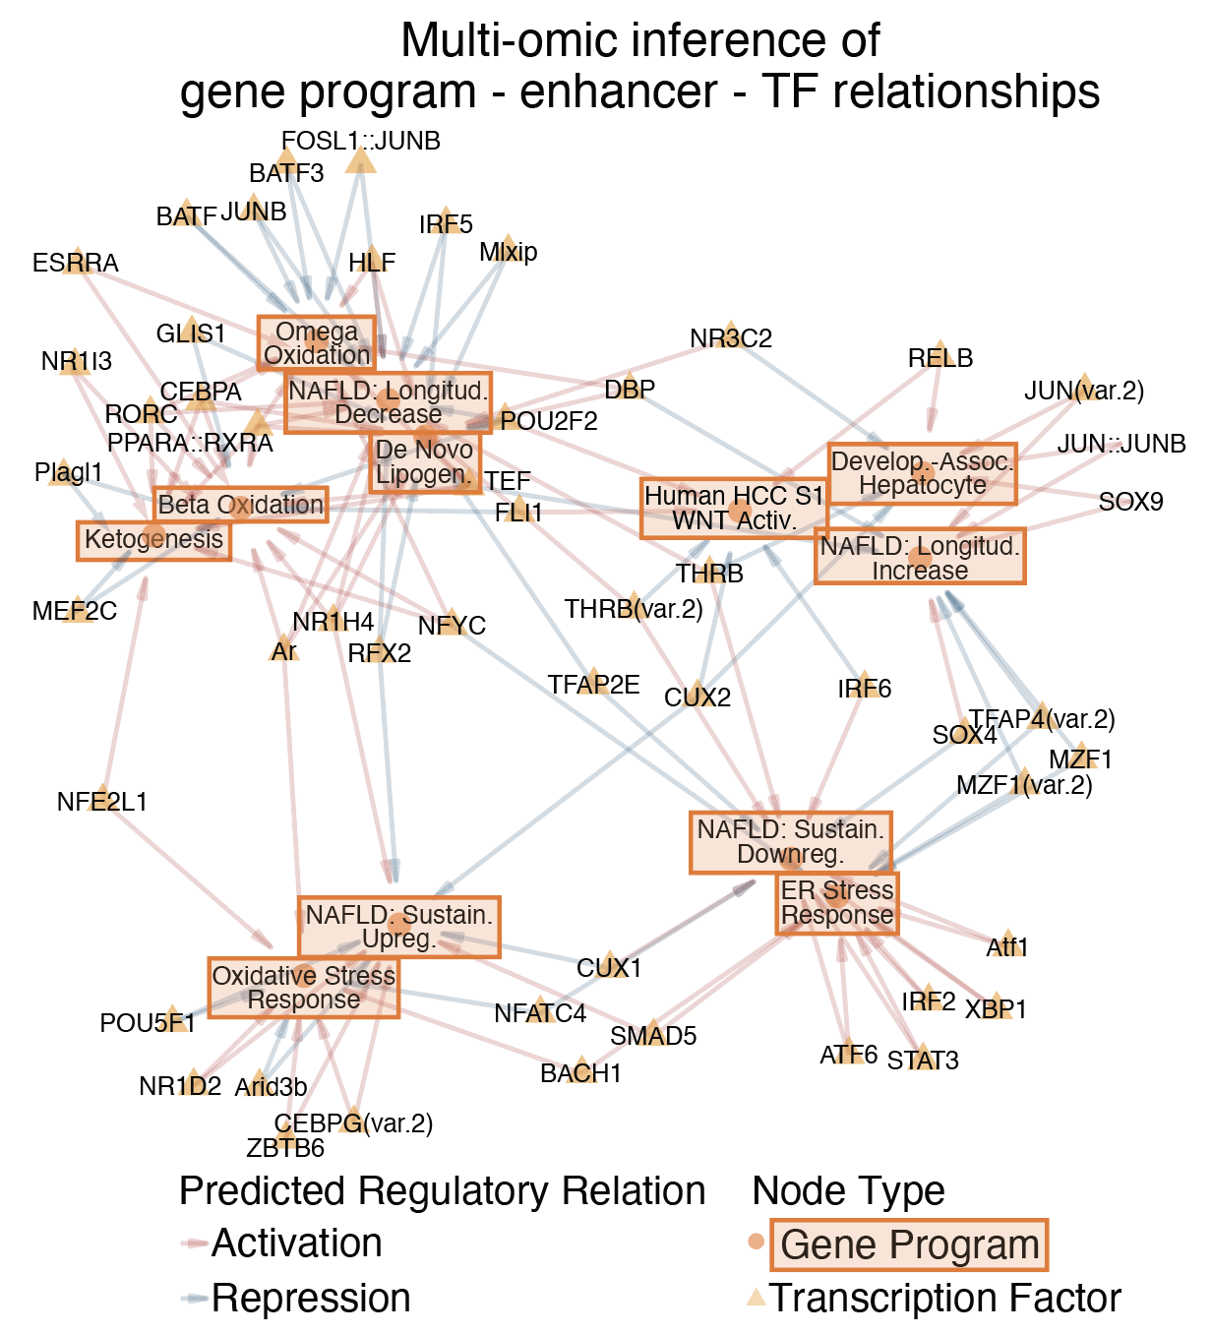
What is uniquely unlocked by having scRNA and scATAC-seq?
Modeling of gene regulatory relationships!
What are examples of single-cell multi-omic analyses?
Hypothesis prioritization for causal variants in GWAS or eQTL studies
Epigenetic priming
Inference of transcription factors driving wide-ranging gene programs
https://shorturl.at/Kysq1
Figure from Tzouanas*, Sherman*, Shay*, et al., bioRxiv (2023)

Slide 18
General Principles and Takeaways
Many possible combinations of methods and protocols; dream big about what pieces of information make sense for your project!*
*subject to constraints on protocol development, sample/resource feasibility, etc.
General principles:
scATAC-seq measures chromatin accessibility throughout the genome
Key challenge: interpreting genomic regions as useful pieces of information
Combined scATAC and scRNA enable a wide variety of gene regulatory analyses – active area of methods development and advances in best practices!
https://shorturl.at/Kysq1

Slide 19
Reading material for wait steps during hands-on demonstration
Some of the steps in the computational hands-on demonstration take a while
During those wait steps, feel free to read some of the papers discussed today!
Google Drive link: https://shorturl.at/su0Wn

